Slide 1
Keeping it Wheel
Group 8 - Final Project

Slide 2
Our Data Analysts
Ashley M
Maheen A
Hassan M
Colleen K
Diana L
Elena O
Vertta M
Vinika P

Slide 3

Buying a car for the first time can be a stressful experience, especially if you’re a recent college graduate. We have a client, Francisco, who has just graduated college and is looking for a new car to commute to his new job. We were hired to predict car prices to help our client make the best economical decision on his car purchase. We used Supervised Machine Learning Algorithms with our Datasets. We also used Jupyter notebook, python, pandas for cleaning and SQL database as our data retrieval source in our ETL process. We then loaded data into an interactive Tableau dashboard and created a website using HTML.
Overview

Slide 4
Data ETL
We used the AWS marketplace to extract 44365 rows and 13 columns from Carvana Car Sales in the United States
Loaded the data into PostgreSQL
Limitation on a dataset of 30,000 random samples to run our models due to memory limitations as well as google colab.

Slide 5

Cleaned Data
After the data was cleaned, we split the data into x and y values
We used X Dummies to get data for the following X columns : year, make, model, miles, trim
Our Y was the sold_price
We split the data into x_train, x_test, y_train, and y_test and used standard scaler to standard scaler to standardize the data

Slide 6
MACHINE LEARNING MODELS
RandomForestTreesRegressor (with parameters)
RandomForestTreesRegressor (without parameters)
DecisionTressRegressor
Linear Regression
KNeighborsRegressor
GradientBoostingRegressor
ExtraTreesRegressor
AdaBoostRegressor
Ridge
Lasso
SVR

Slide 7
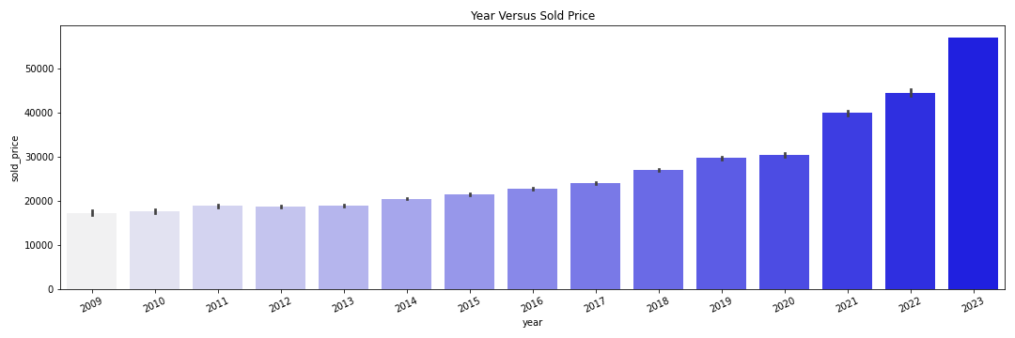
Year Versus Sold Price Bar Plot Image
INSERT IMPORTANT NUMBERS
While mostly a standard increase in price from year to year, one thing of note is a significant jump between 2020 and 2021 and 2022 and 2023.

Slide 8
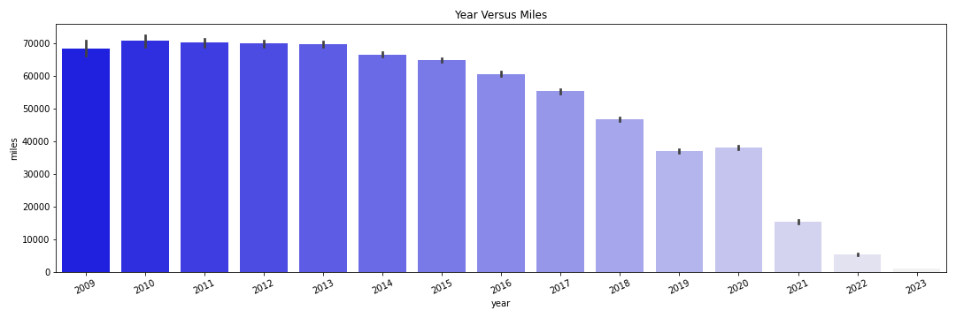
Year vs Miles Bar Plot
We can see a correlation between age of car and miles. This is because the newer the car, the less miles it has.

Slide 9
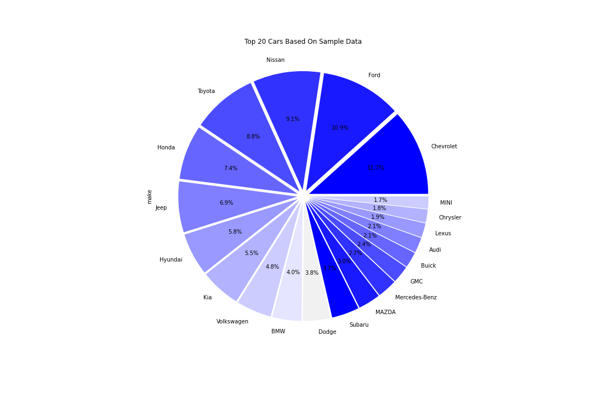
Pie Chart of Values
Based on our sample data, the top 3 most sold cars are Nissan, Ford, and Chevrolet.

Slide 10
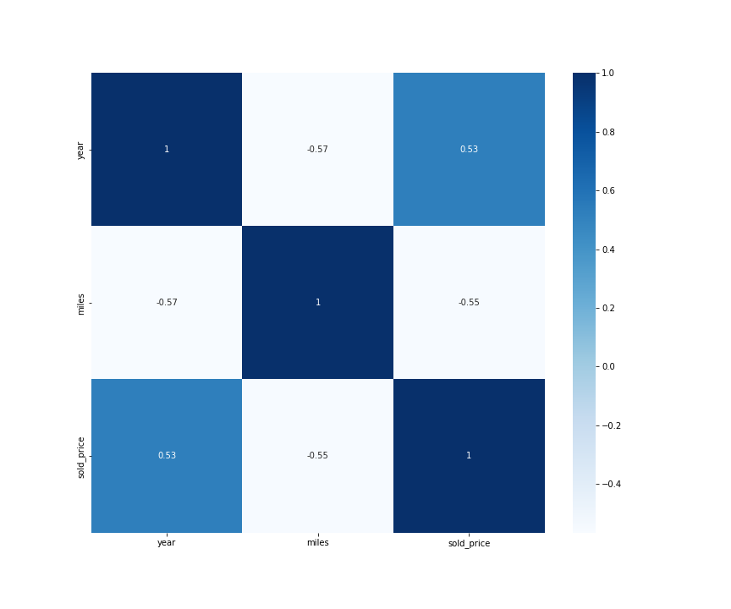
Heatmap of year, miles, sold price
This heat map shows a positive correlation between year and sold price. The newer the model of car, the more it costs.

Slide 11
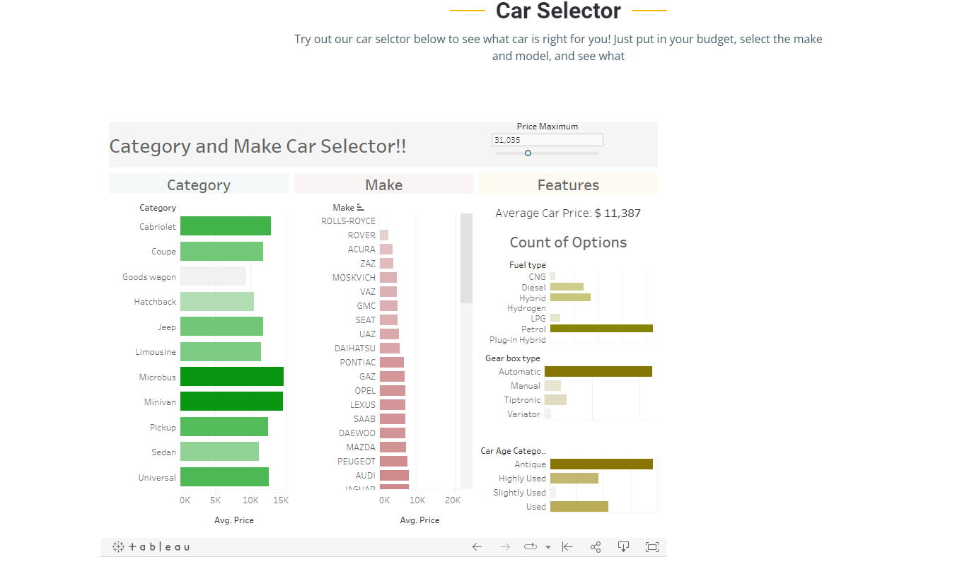
Tableau: Car Selection Dashboard
Used a dataset that is also up to date and contained more car features
Created price filter using a parameter and created calculated field that checks if price is within range with T/F statements
Generated car age calculated field and put them into strings using If/Else
Within dashboard, 2 action filters were made for category and make

Slide 12
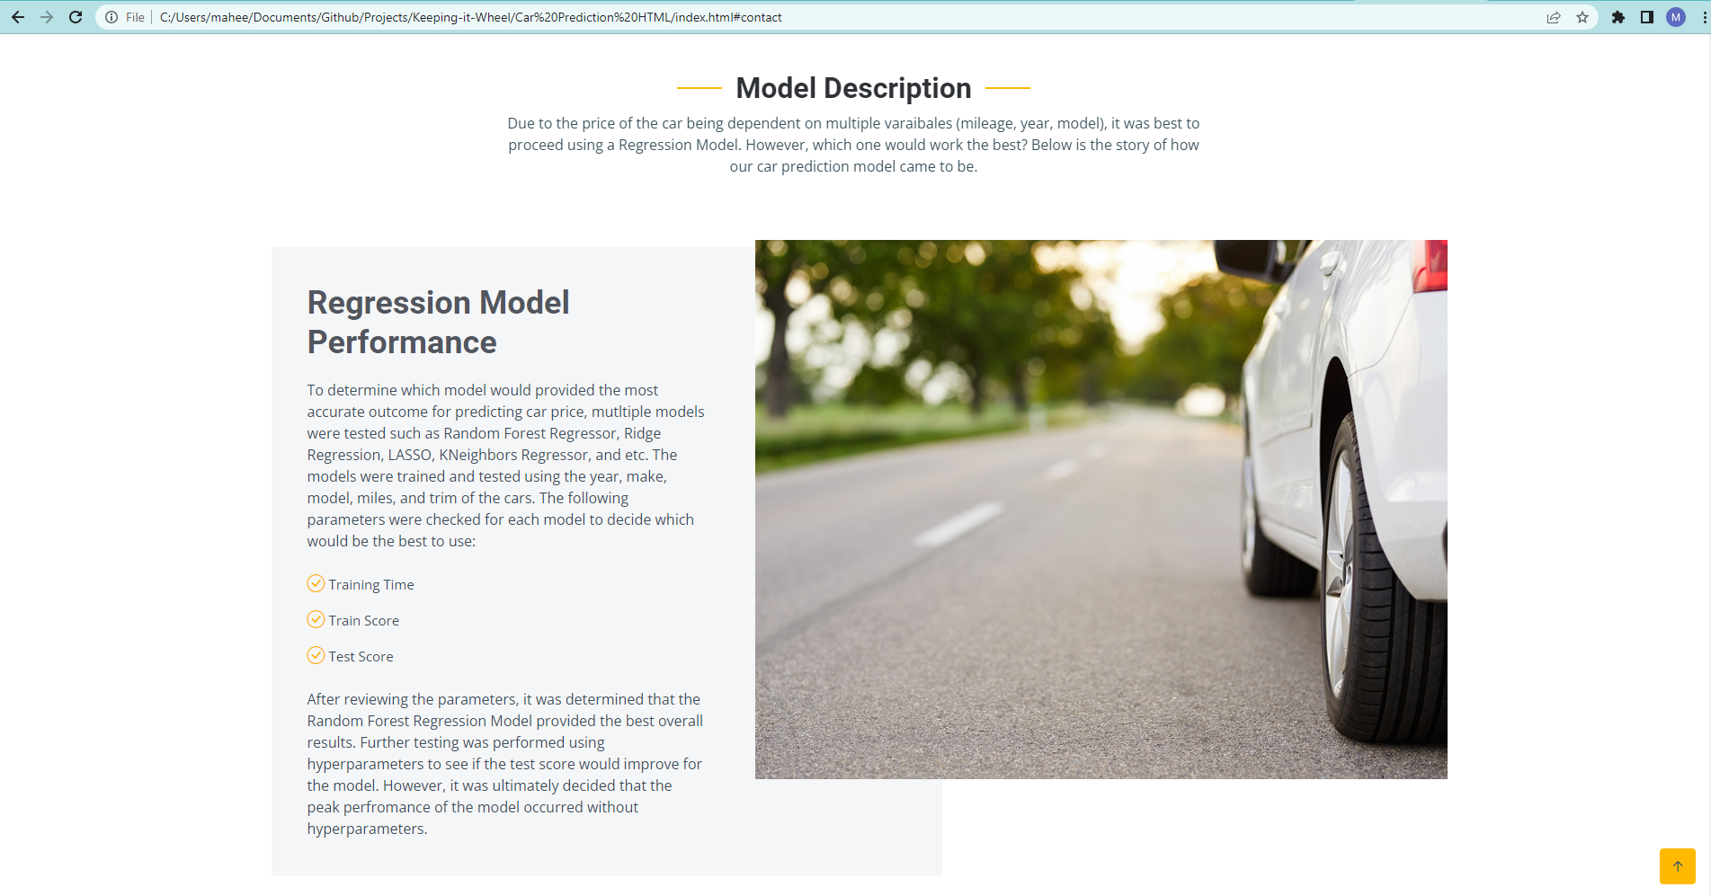
Website Creation
Using a bootstrap HTML template, we created a website containing background information on the regression model, our tableau dashboard and multiple plots to show trending of data.

Slide 13
With our car prediction model and interactive dashboard, we feel that Francisco will have enough information on car prices and car options available to him. He will be able to make the best economical decision in choosing his first car.

Slide 15
Resources
https://www.moneyunder30.com/how-much-car-can-you-afford
https://www.businesswire.com/news/home/20220824005118/en/Cost-of-Car-Ownership-in-the-U.S.-Increases-5-as-the-Average-American-Household-Now-Spends-Over-600-a-Month-on-Auto-Loans-and-Insurance-Combined
https://www.kaggle.com/datasets/deepcontractor/car-price-prediction-challenge
https://thecleverprogrammer.com/2021/08/04/car-price-prediction-with-machine-learning/
https://aws.amazon.com/marketplace/pp/prodview-y77x3t6zisn4w?sr=0-2&ref_=beagle&applicationId=AWSMPContessa#offers

Slide 16
THANK YOU!
Ashley M
Maheen A
Hassan M
Colleen K
Diana L
Elena O
Vertta M
Vinika P

